Slide 1
Introduction
Hello everyone, my name is Maaria Shaikh, and today I’ll be walking you through my final project for the course Artificial Intelligence and Expert Systems — a Spam Email Detector.
Spam detection is one of the most common and practical applications of Natural Language Processing. It helps filter out unwanted or malicious messages from inboxes. I’ll demonstrate how I used machine learning — specifically the Naive Bayes Classifier — to build a working spam filter from scratch using Python.

Slide 2
Problem Statement
The problem I aimed to solve was to automatically classify SMS messages as either ham (genuine) or spam. This is a classic text classification problem and a good use case for applying machine learning and AI principles.
The goal is to make this process automatic, scalable, and as accurate as possible — something very useful for email clients, messaging apps, and businesses to prevent scams or phishing attempts.

Slide 3
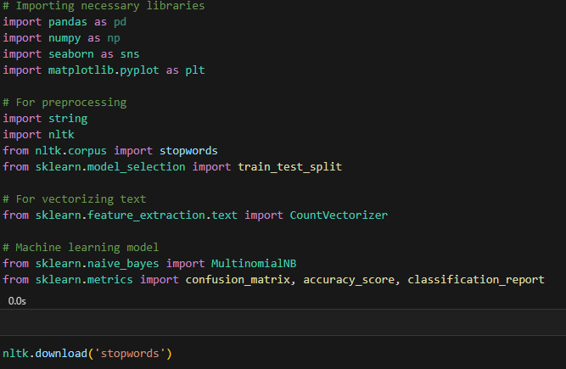
Code Walkthrough
Importing Libraries
We import libraries for data handling, preprocessing, and building a machine learning pipeline using scikit-learn.

Slide 4
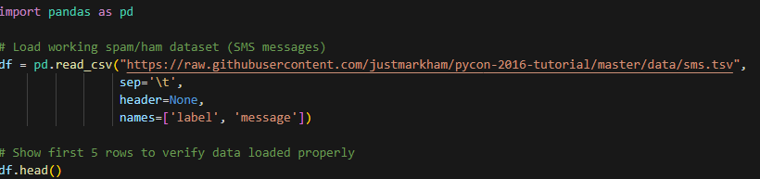
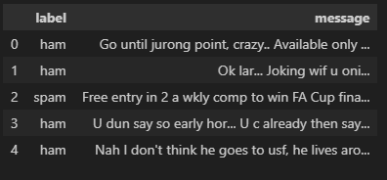
Data Set Overview
I used a public SMS dataset containing about 5,500 messages, each labeled as either ‘ham’ or ‘spam’. I loaded this dataset using pandas and displayed the first few rows to verify the structure. The two columns are 'label' and ‘message’.

Slide 5
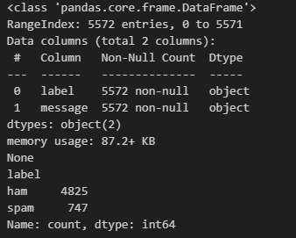
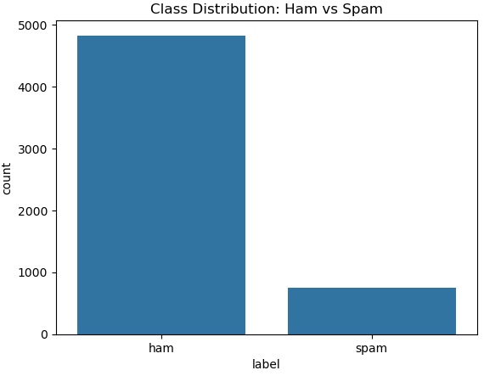
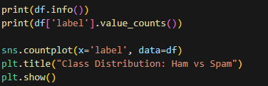
Exploring Class Distribution
Here, I checked how balanced the dataset is. As shown, there are more ham messages than spam — which is common in real-life data. This imbalance is important to consider during model evaluation to avoid biased accuracy.

Slide 6
Text Preprocessing
Next comes preprocessing. Raw text data isn’t directly usable by ML models, so I cleaned the messages by:
Lowercasing everything,
Removing punctuation,
Removing stopwords like “the”, “is”, and “and” which don’t add value.
This helps in reducing noise and focusing on keywords that actually differentiate spam from ham.

Slide 7
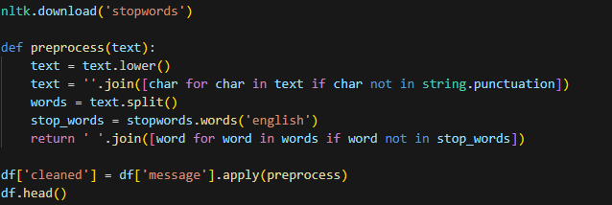
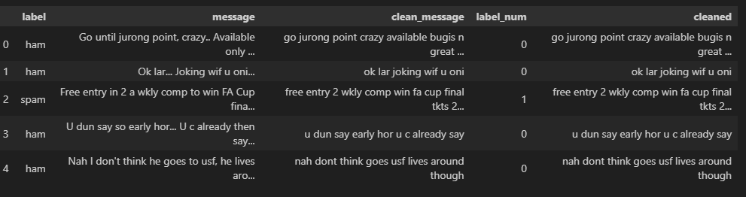

Slide 8

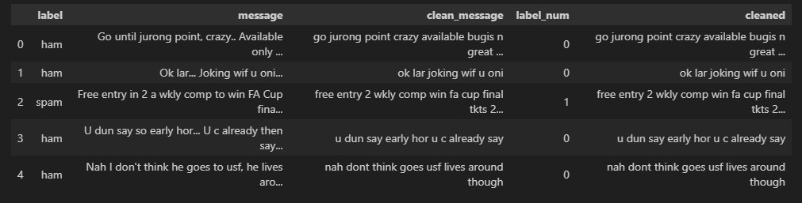
Converting Labels
Then, I converted the labels into numerical form: 0 for ham and 1 for spam. This is essential because machine learning algorithms can not process text labels they work with numbers.

Slide 9
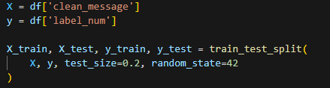
Splitting the Data
I split the dataset into training and testing sets using an 80/20 ratio. The training set is used to teach the model patterns, and the test set checks how well the model performs on unseen data.

Slide 10

Text Vectorization
Here I used CountVectorizer, which turns the text into a matrix of token counts. This is a basic and effective way to convert text into numbers. For instance, words like “win”, “free”, and “congratulations” might be more common in spam, and this helps capture those patterns.

Slide 11

Naive Bayes Classifier
I trained the model using a Multinomial Naive Bayes Classifier. This algorithm is ideal for text classification because it works well with discrete features like word counts. It’s based on Bayes' theorem and assumes independence between features — which is often not strictly true but works surprisingly well in practice.

Slide 12
Model Evaluation
most spam and ham messages were correctly identified. Off-diagonal ones represent misclassifications, which were very few.
I evaluated the model using accuracy and classification metrics. The accuracy was quite high — which means it predicted most of the messages correctly. But accuracy alone isn’t enough, especially with imbalanced data, so I looked at precision, recall, and F1-score, which were also strong.
The Confusion Matrix Shows how many Correct and Incorrect predictions were made. The diagonal values indicate correct predictions most spam and ham messages were correctly identified. Off–diagonal ones represent misclassifications, which were very few.

Slide 13
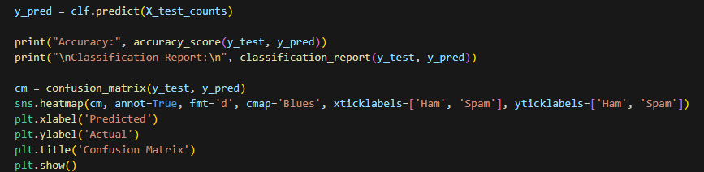
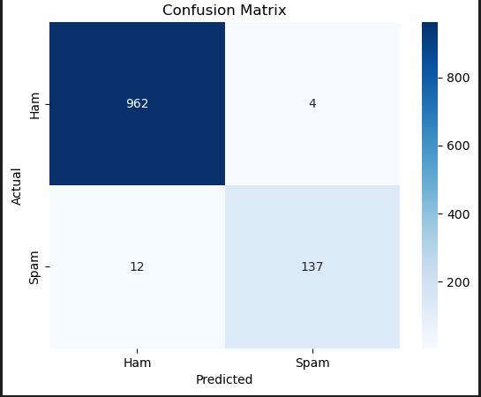
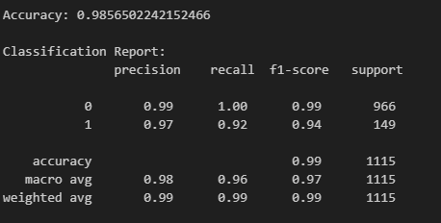

Slide 14
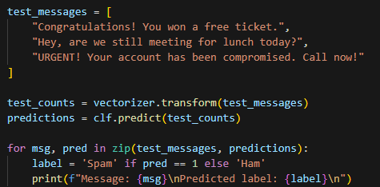
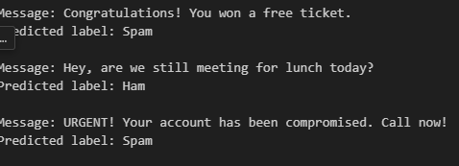
Real-world Testing
Finally, I tested the model with some custom messages. As expected, messages with words like “Congratulations” or URGENT” were correctly flagged as spam. Casual texts like the lunch message were classified as ham. This shows the model generalizes well to new, unseen data.

